Slide 1
Introduction to Deep Learning: Algorithms and Their Applications
CDC Short Course
Xiaoming Huo, Georgia Tech

Slide 2
Schedule
8:30-9:30 Lecture 1: Introduction
9:45-10:45 Lecture 2: Course Materials and Resources
11:00-12:00 Lecture 3: Perceptron
12:00-1:15 Lunch break
1:15-2:00 Lecture 4: Neural Network, Software
2:15-3:00 Lecture 5: Convolution Networks
3:15-4:00 Lecture 6: Some Examples
4:00 Adjourn
Online resources: https://github.com/xhuo17/DL2022CDC

Slide 3
materials
software
ndarray
Goals
• Introduction to Deep Learning
(basic MLP, optimization, convolutions, sequences)
• Theory
• Capacity control (weight decay, dropout, batch norm)
• Optimization, models, overfitting, objective functions
• Practice
• Write code in Python / MxNet Gluon / Jupyter
• Solve realistic problems
• Project
• Ability to start original research in Deep Learning in a team

Slide 4
Course Materials
materials
software
ndarray
We use Dive into Deep Learning (https://d2l.ai/)
An interactive deep learning book with code, math, and discussions
Each section is an executable Jupyter notebook
Active community support
D2L as a textbook or a reference book
A part of D2L

Slide 5
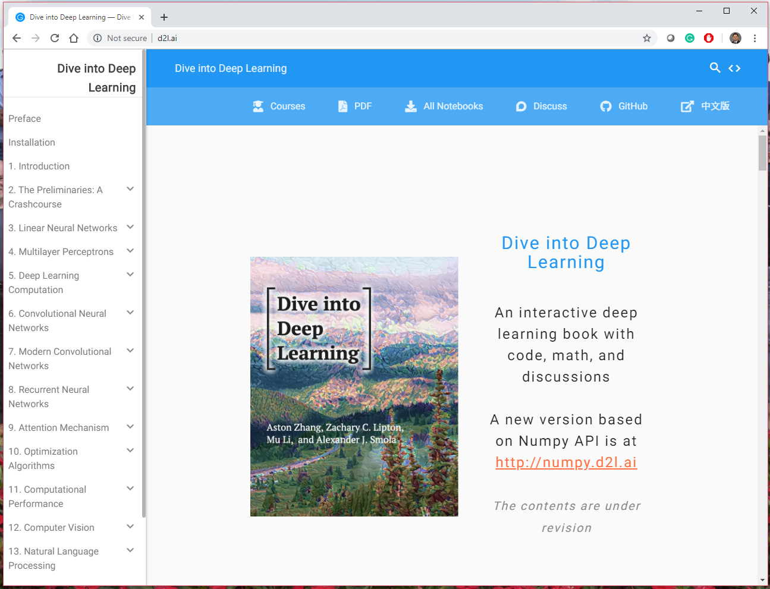
Dive into Deep Learning
materials
software
ndarray
https://d2l.ai/

Slide 6
Based on the NumPy interface
materials
software
ndarray
http://numpy.d2l.ai/

Slide 7
A Berkeley Course
materials
software
ndarray
Introduction to Deep Learning
STAT 157, UC Berkeley, Spring, 2019
http://courses.d2l.ai/berkeley-stat-157/index.html
https://github.com/d2l-ai/berkeley-stat-157

Slide 8
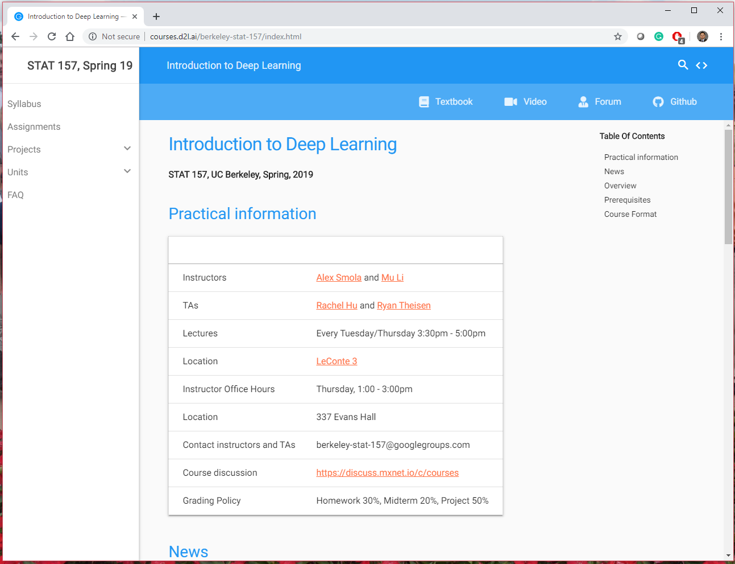
STAT 157, UC Berkeley, Spring, 2019
materials
software
ndarray
http://courses.d2l.ai/berkeley-stat-157/index.html

Slide 9
Table of contents of the book
materials
software
ndarray
Preface
Installation
1. Introduction
2. The Preliminaries: A Crash course
3. Linear Neural Networks
4. Multilayer Perceptrons
5. Deep Learning Computation
6. Convolutional Neural Networks
7. Modern Convolutional Networks
8. Recurrent Neural Networks
9. Attention Mechanism
10. Optimization Algorithms
11. Computational Performance
12. Computer Vision
13. Natural Language Processing
14. Recommender Systems
15. Generative Adversarial Networks
16. Appendix
References

Slide 10
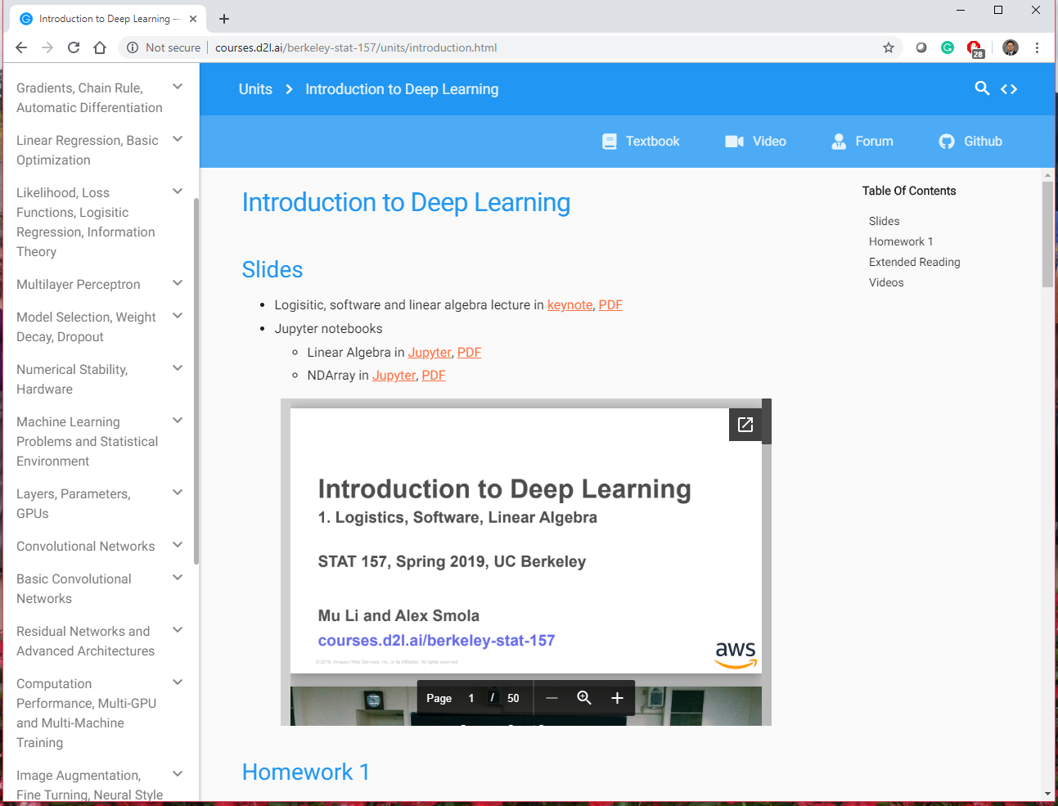
How to find more…
materials
software
ndarray
courses.d2l.ai/berkeley-stat-157/units/introduction.html

Slide 11

materials
software
ndarray
Software
courses.d2l.ai/berkeley-stat-157

Slide 12
Agenda
materials
software
ndarray
Anaconda
Jupyter Notebooks,
Reproducible Research
GitHub – version control

Slide 13
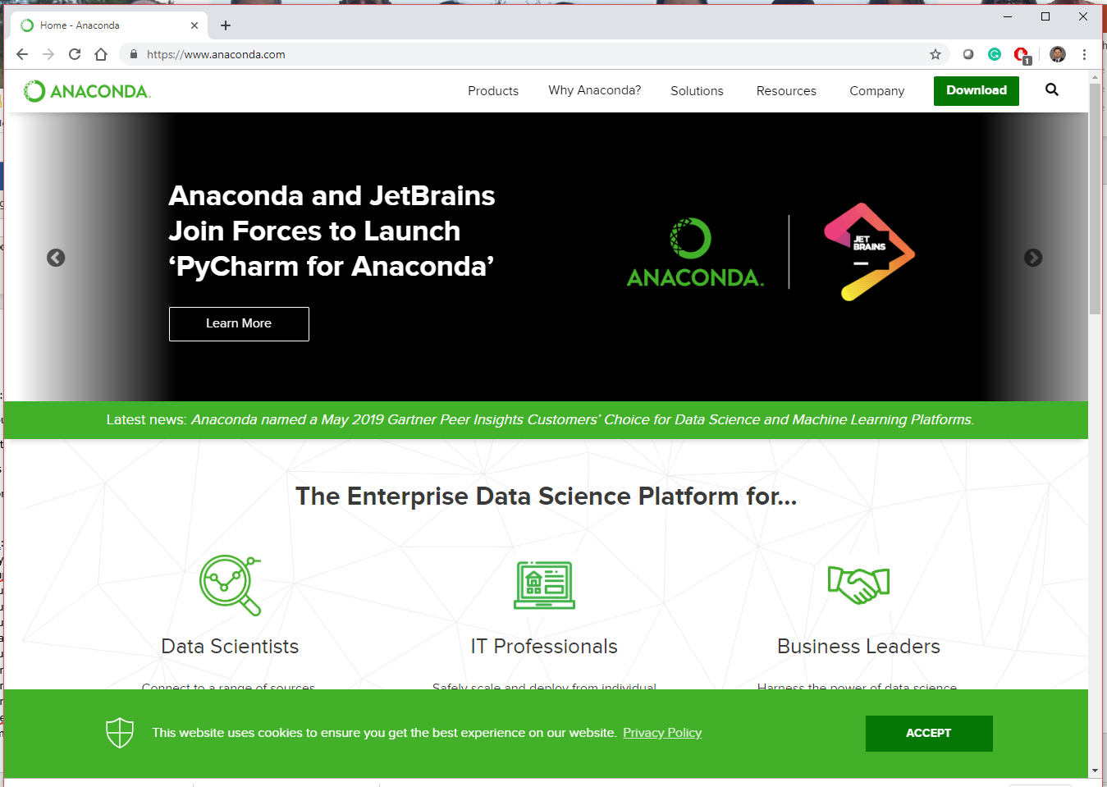
Anaconda
materials
software
ndarray
https://www.anaconda.com/

Slide 14
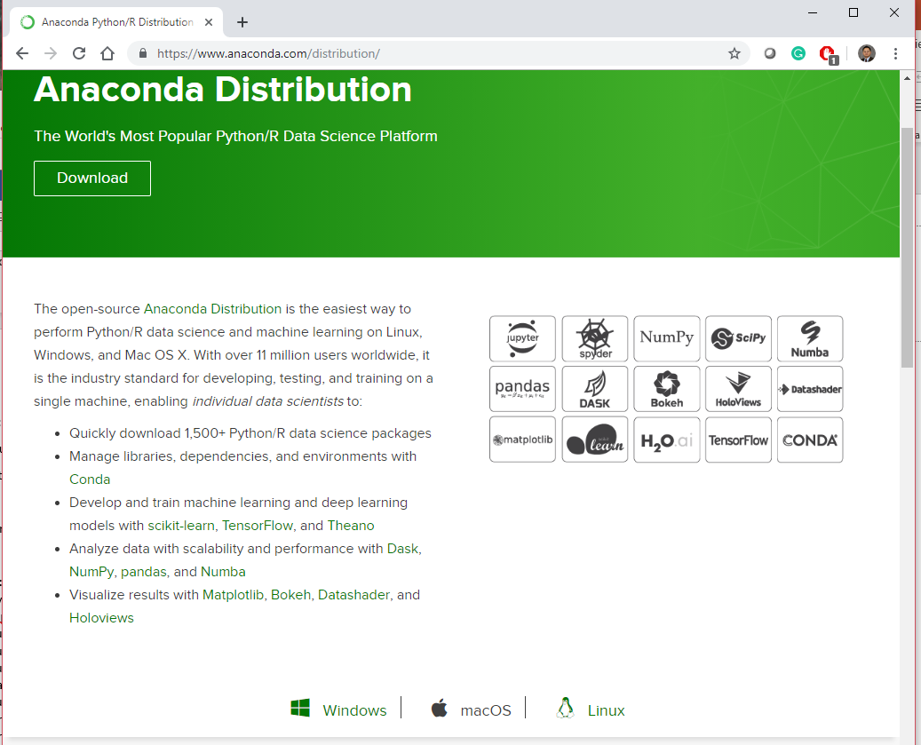
Download
materials
software
ndarray
https://www.anaconda.com/distribution/

Slide 15
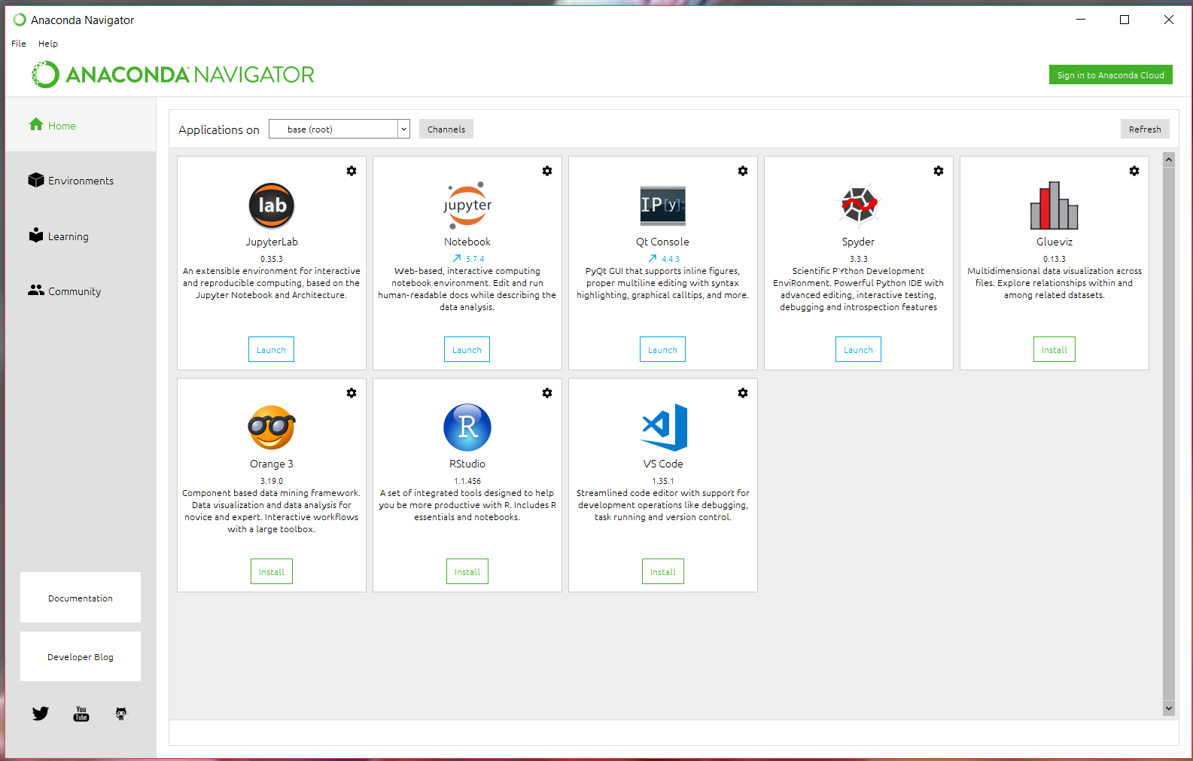
After installation
materials
software
ndarray

Slide 16
What is Conda?
Conda is an open source package and environment management system that runs on Windows, Mac OS and Linux.
Conda can quickly install, run, and update packages and their dependencies.
Conda can create, save, load, and switch between project specific software environments on your local computer.
Although Conda was created for Python programs, Conda can package and distribute software for any language such as R, Ruby, Lua, Scala, Java, JavaScript, C, C++, FORTRAN.

Slide 17
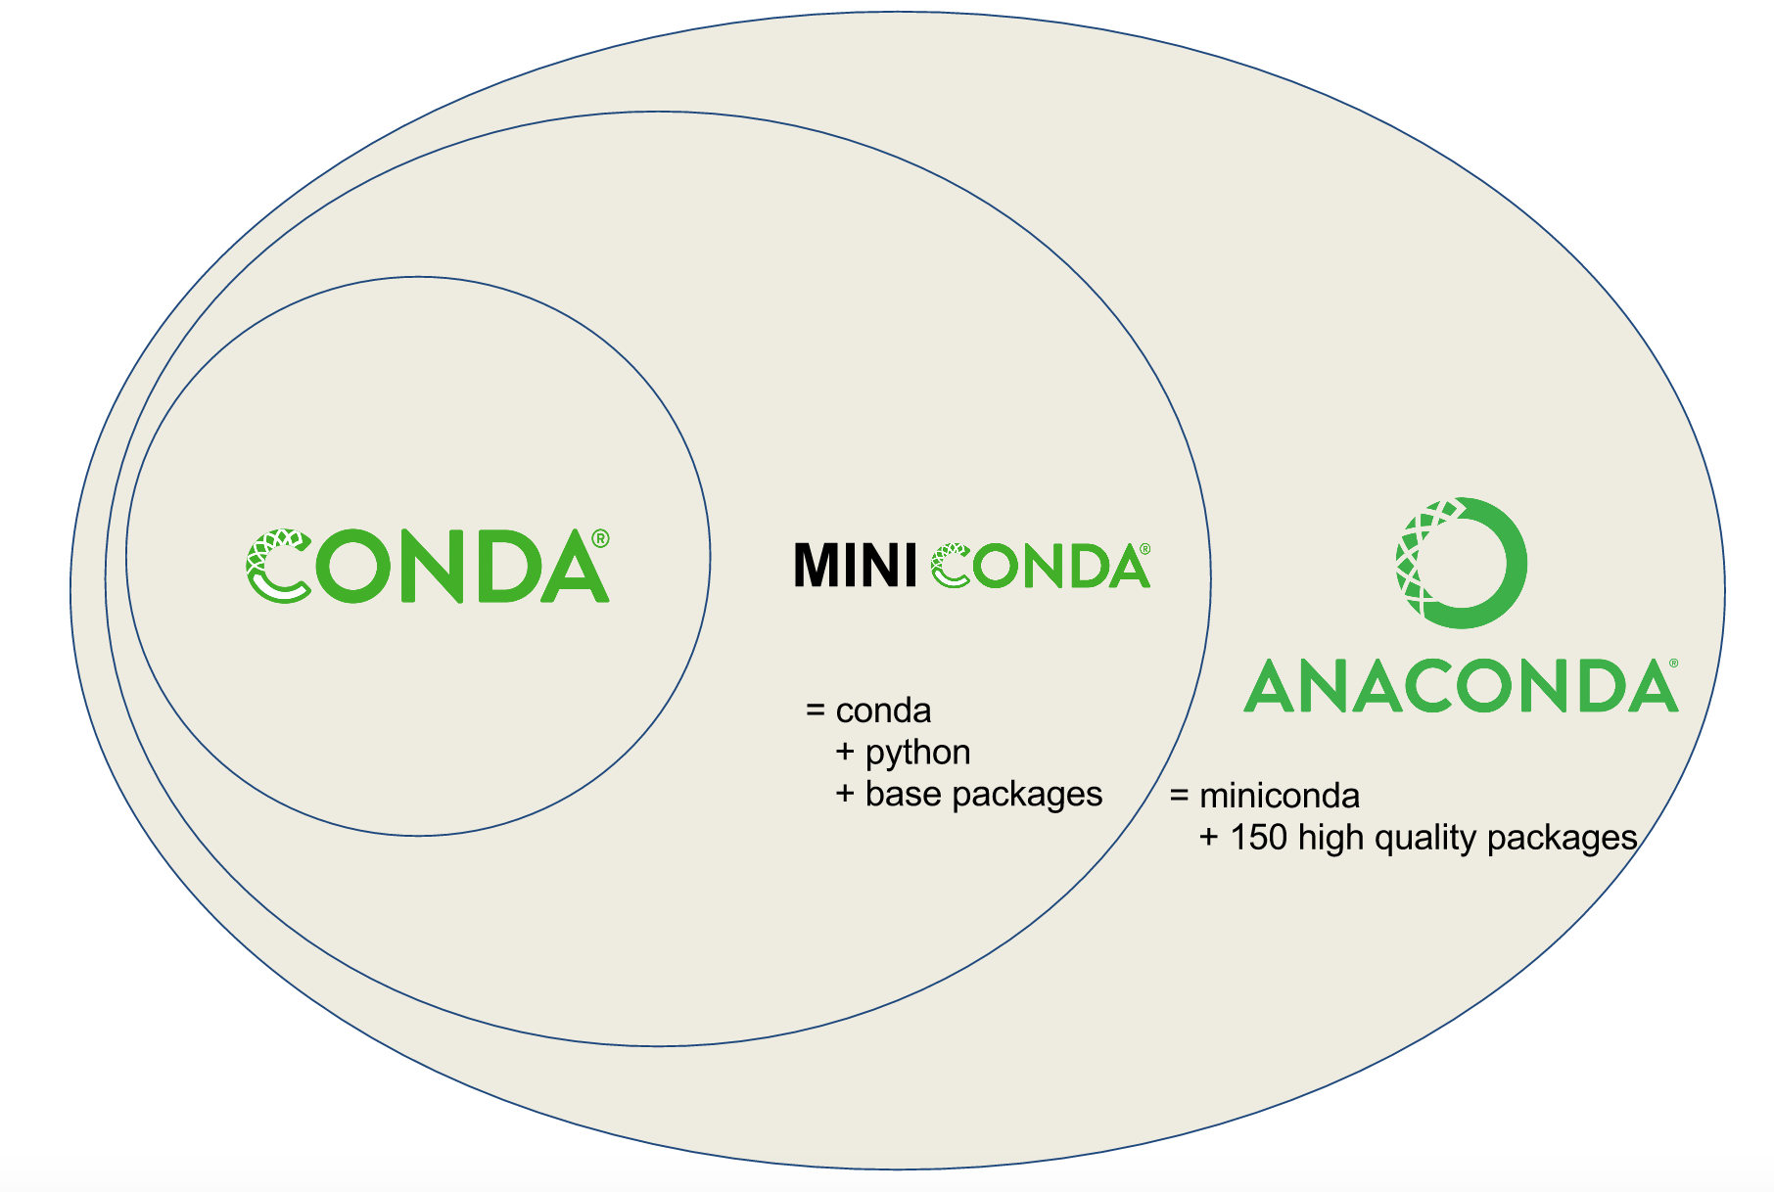
What is Anaconda?
https://kaust-vislab.github.io/python-novice-gapminder/00-getting-started-with-conda/index.html

Slide 18

GitHub
materials
software
ndarray

Slide 19
materials
software
ndarray
Tools
• Python
d2l.ai/chapter_crashcourse/install.html
• Everyone is using it in machine learning & data science
• Conda package manager (for simplicity)
• Jupyter
• So much easier to keep track of your experiments
• Obviously, you should put longer code into modules
• Reveal (for notebook slides)
conda install -c conda-forge rise
• Apache MXNet Gluon
• Scalability & ease of use
• Imperative interface
courses.d2l.ai/berkeley-stat-157

Slide 20
Installation
Installing Anaconda (mentioned earlier)
Anaconda Prompt ->
  “conda create --name d2l python=3.8 -y”
Downloading the D2L Notebooks:
  “mkdir d2l-en
  cd d2l-en
  curl https://www.d2l.ai/d2l-en.zip -o d2l-en.zip
  unzip d2l-en.zip
  rm d2l-en.zip”

Slide 21
Installation (2)
Activate the d2l environment:
  “conda activate d2l”
Install MxNet
  "pip install mxnet==1.7.0.post1"
Upgrade all packages to the newest version
  "pip install -U d2l"
Debug:
  https://d2l.ai/chapter_installation/index.html

Slide 22
materials
software
ndarray
Laptop / Desktop with Windows
• GPU
• Install NVIDIA drivers / CUDA / CUDNN / TensorRT
• Update environment.yml to replace mxnet with mxnet-cu92

Slide 23
materials
software
ndarray
AWS (via Deep Learning AMI)
• Install Base AMI (Ubuntu with NVIDIA drivers)
• aws.amazon.com/machine-learning/amis/
• aws.amazon.com/marketplace/pp/B077GFM7L7
• Follow steps for basic MXNet / Jupyter install as before
• For P2 / P3 / G2 / G3 instances NVIDIA drivers default
• Update the Conda environment
• SSH with port forwarding
• d2l.ai/chapter_appendix/jupyter.html
• d2l.ai/chapter_appendix/aws.html (setting up AWS account)

Slide 24
materials
software
ndarray
Colab
• Go to colab.research.google.com
• Activate the GPU supported runtime (this is a K80 GPU)
• Install MXNet
!pip install mxnet-cu92
!pip install d2l

Slide 25
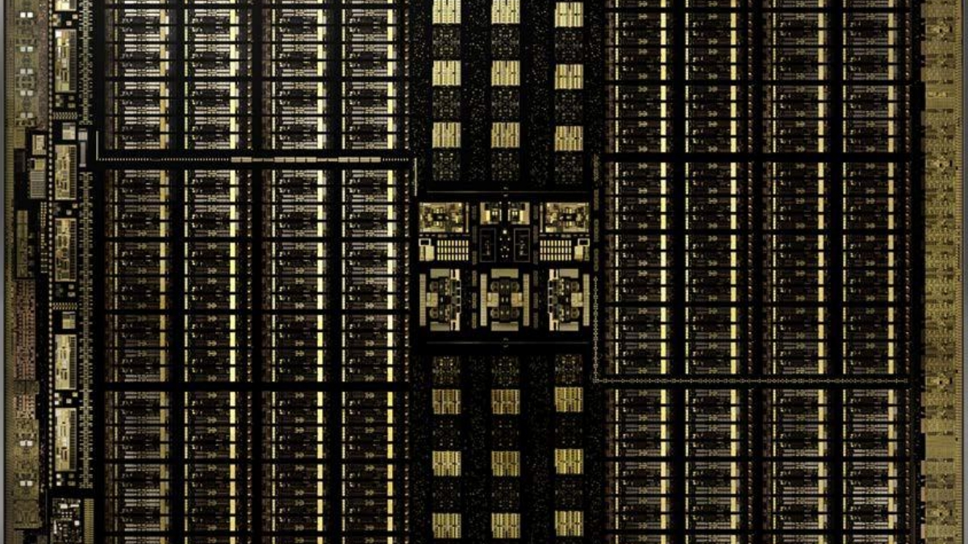
materials
software
ndarray
GPUs love matrices and vectors
(they have many processors)
courses.d2l.ai/berkeley-stat-157

Slide 26
materials
software
ndarray
ndarray
courses.d2l.ai/berkeley-stat-157

Slide 27
materials
software
ndarray
N-dimensional Array Examples
• N-dimensional array, short for ndarray, is the main data
structure for machine learning and neural networks
0-d (scalar)
1.0
A class label
1-d (vector)
[1.0, 2.7, 3.4]
A feature vector
2-d (matrix)
[[1.0, 2.7, 3.4] [5.0, 0.2, 4.6] [4.3, 8.5, 0.2]]
A example-by- feature matrix

Slide 28









materials
software
ndarray
ND Array Examples, cont
3-d
[[[0.1, 2.7, 3.4] [5.0, 0.2, 4.6] [4.3, 8.5, 0.2]]
[[3.2, 5.7, 3.4] [5.4, 6.2, 3.2] [4.1, 3.5, 6.2]]]
A RGB image (width x height
x channels)
4-d
[[[[. . .
. . .
. . .]]]
A batch of RGB images (batch-size x width x height x channels)
5-d
[[[[. . .
. . .
. . .]]]
A batch of videos (batch-size x time x width x height x channels)

Slide 29
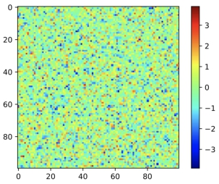
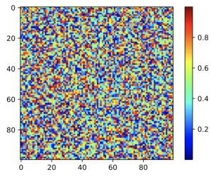
materials
software
ndarray
Create Arrays
• Create arrays with
• A shape, e.g. 3-by-4 matrix
• Data type for each element, e.g. float
• Element values, e.g all 0s, or random values
A normal distribution A uniform distribution
100-by-100 matrix
with elements generated from

Slide 30
materials
software
ndarray
Access Elements
An element: [1, 2]
0 1 2 3
A row: [1, :]
0 1 2 3
A column: [:, 2]
0 1 2 3
0 1 2 3
1 2 3 4
5 6 7 8
9 10 11 12
13 14 15 16
0 1 2 3
1 2 3 4
5 6 7 8
9 10 11 12
13 14 15 16
0 1 2 3
1 2 3 4
5 6 7 8
9 10 11 12
13 14 15 16
0 1 2 3
1 2 3 4
5 6 7 8
9 10 11 12
13 14 15 16
0 1 2 3
1 2 3 4
5 6 7 8
9 10 11 12
13 14 15 16
0 1 2 3
0 1 2 3

Slide 31
materials
software
ndarray
Pointers
• d2l.ai/chapter_crashcourse/ndarray.html
• beta.mxnet.io/guide/crash-course/1-ndarray.html
• Gilbert Strang’s Linear Algebra course
github.com/juanklopper/MIT_OCW_Linear_Algebra_18_06
• Berkeley HPC course (GPU sections)
sites.google.com/lbl.gov/cs267-spr2018/

Slide 32
materials
software
ndarray
Summary
• Links for online resources
Course materials, URLs
• Software
Installation, cloud
• Linear Algebra
Basic notation
• NDArray

Slide 33
Schedule
materials
software
ndarray
8:30-9:30 Lecture 1: Introduction
9:45-10:45 Lecture 2: Course Materials and Resources
11:00-12:00 Lecture 3: Perceptron
12:00-1:15 Lunch break
1:15-2:00 Lecture 4: Neural Network, Software
2:15-3:00 Lecture 5: Convolution Networks
3:15-4:00 Lecture 6: Some Examples
4:00 Adjourn
Online resources: https://github.com/xhuo17/DL2022CDC

